Slide 1
Intellectual Property (LECTURE)
Andrew Peck

Slide 2
Reflections to Have
What level is this relevant to me?
As an individual consumer?
As an employee/technical creator
As a decision maker
As an investor/business owner
As government
Notes:
https://www.gov.uk/government/news/intelligence-agencies-provide-briefings-on-foreign-interference

Slide 3
Objectives
By the end you should understand:
What is IP
UK Institutional Landscape
Role of UK IPO
Courts
International and Technological Contemporary context

Slide 4
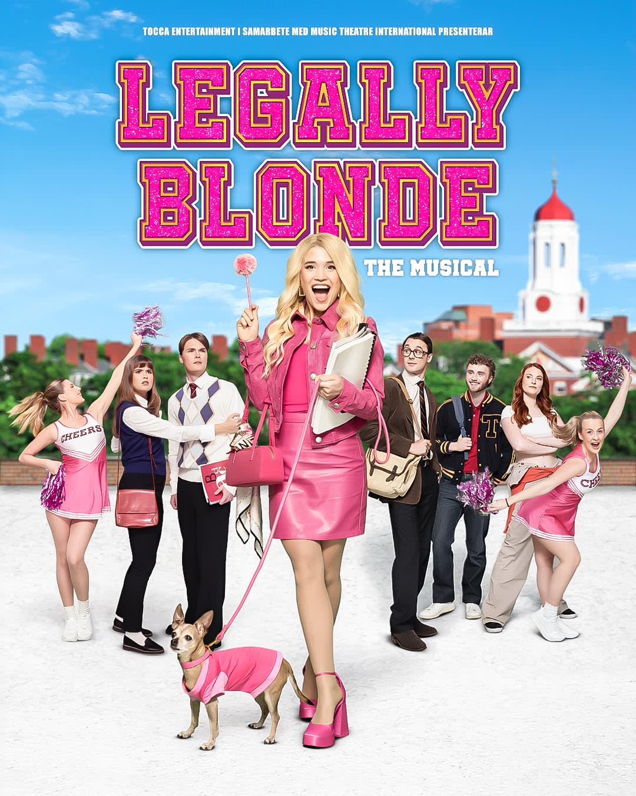
Not in today’s lecture
International regimes (but they matter to global digital ecosystems)
Non-UK legal traditions/ways of working
… your favourite episode of Suits/ Legally Blonde

Slide 5
What is IP?
Intellectual property is something that you create using your mind - for example, a story, an invention, an artistic work or a symbol. (UK IPO)
intellectual property rights are rule governed privileges that regulate the ownership and exploitation of abstract objects in many fields of human activity
(Drahos, 2016)
MSc Level understanding:
An innovation control mechanism
A commercialisation lever
A governance tool in digital ecosystems
A risk surface in cyber systems
Notes:
https://www.gov.uk/intellectual-property-an-overview
Drahos, Peter. A philosophy of intellectual property. Routledge, 2016.

Slide 6
Foundations (why we’re told it matters)
Incentives
Natural Rights
Utilitarian Balance
Market Signalling

Slide 7
Critiques
1 minute: What downsides of IP protection can you think of?
Over-propertisation of knowledge
Anti-commons problem
Innovation chilling effects
Platform capitalism tensions

Slide 8
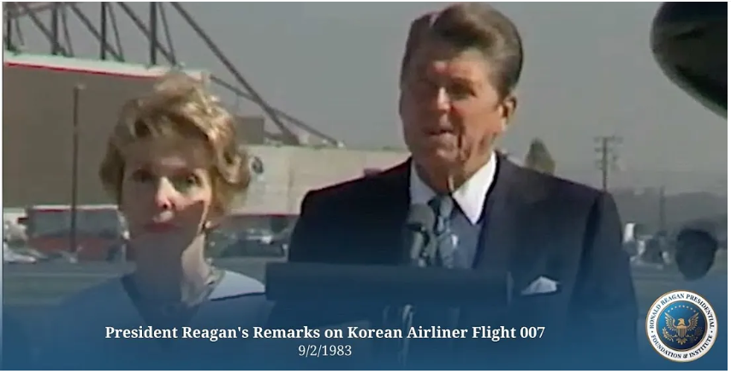
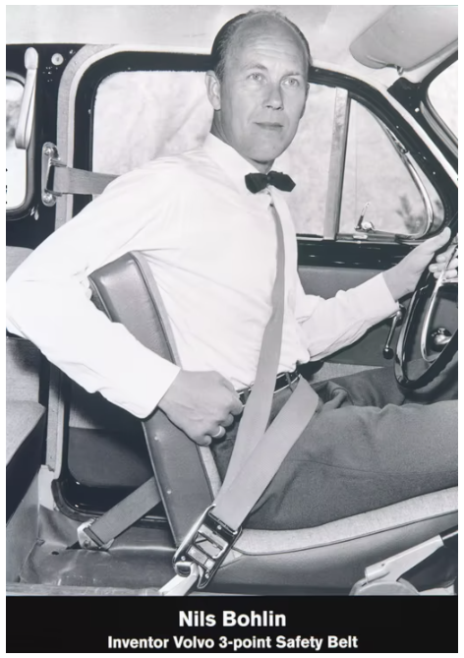
When IP is given away?
Does/Should IP protection always take precedence?
What do Volvo and Ronald Reagan have in common?
Notes:
https://www.volvogroup.com/en/about-us/heritage/three-point-safety-belt.html
September 1st 1983, KAL 007 – SHOT DOWN by soviets.
https://www.koreaherald.com/article/3162458

Slide 9
4 pillars of IP Protection

Slide 10
Copyright
Protecting creative works and originality
Statutory basis
Copyright, Designs and Patents Act 1988
Key doctrinal elements
Originality (UK/EU standard)
Author’s own intellectual creation
Low but meaningful threshold
Fixation requirement
Economic vs moral rights
Subsistence in software
Source code vs object code
Non-literal copying
Structure, sequence, organisation

Slide 11
Key Case (Copyright)
Background
The dispute arose when Infopaq International, a Danish media monitoring company, used automated scanning to create summaries of newspaper articles. The Danish Newspaper Publishers’ Association (Danske Dagblades Forening) argued this process infringed copyright by reproducing parts of protected works. The case was referred by a Danish court to the CJEU for interpretation of EU copyright law.
Judgment and reasoning
The Court ruled that reproducing even an 11-word extract from a protected work may constitute reproduction “in part” under Article 2 of the InfoSoc Directive if it contains elements reflecting the author’s intellectual creation. The decision emphasized qualitative rather than quantitative assessment of originality, establishing a key EU-wide standard for determining copyright subsistence in digital environments.
Legal and practical impact
Infopaq was the CJEU’s first major interpretation of the InfoSoc Directive and became foundational for later judgments defining the “author’s own intellectual creation” test. It significantly affected digital content industries, news aggregation services, and national courts’ understanding of partial reproduction and originality in European copyright law.
Notes:
Court: Court of Justice of the European Union (CJEU)
Decision date: July 16, 2009
Case number: C-5/08
Core issue: Copyright protection of short text extracts
Legal basis: EU Copyright Directive (InfoSoc Directive)

Slide 12
Patents
Protecting invention and rights to its exploitation
Statutory basis
Patents Act 1977
Patentability framework (four-stage test)
Identify the claim
Identify the contribution
Ask if it falls solely within excluded matter
Check technical nature (rather than just a “way of working”)

Slide 13
Key Case (Patents)
Aerotel Ltd v Telco Holdings Ltd
Court: Court of Appeal (Civil Division), England and Wales
Year decided: 2006
Citation: [2006] EWCA Civ 1371
Background
The dispute arose over Aerotel Ltd’s patent for a telephone call handling system. The UK Intellectual Property Office had refused Telco Holdings’ related patent application, leading to appeals that questioned the limits of what constitutes a patentable invention. The case was heard alongside Macrossan’s Application, which also concerned computer-related inventions.

Slide 14
What counts in our field?
Excluded “as such”:
Computer programs
Mathematical methods
Business methods
But patentable if:
Technical contribution
Technical effect
Technical solution to technical problem
Cybersecurity examples (excellent for engagement)
Patentable:
Novel packet inspection architecture
Hardware-based trust anchor
New cryptographic hardware implementation
Usually not patentable:
Pure detection algorithm
Risk scoring model
Abstract ML classification

Slide 15
Key Patent topics
Defensive patenting and market signalling
Open vs proprietary tension (Linux vs Microsoft?)

Slide 16
Trade marks™
Statutory basis
Trade Marks Act 1994
Why do we need trademarks?
Origin function
Quality guarantee
Advertising function
Investment function (advanced concept)

Slide 17
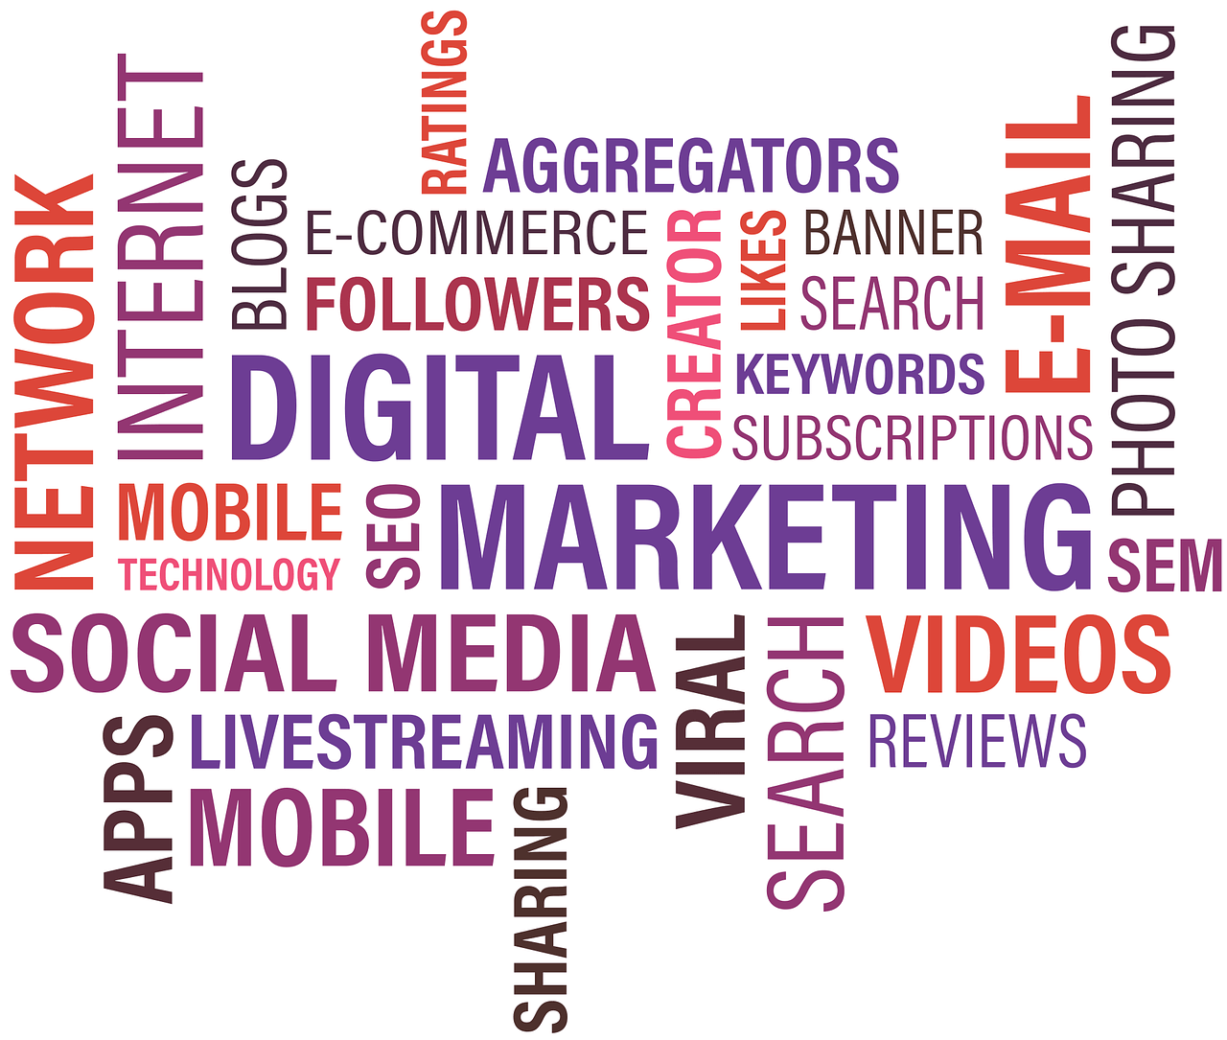
Relevance to you
Goodwill
Misrepresentation
Damage
Domain name disputes
Keyword advertising
Platform impersonation
Typosquatting
OFFENCE of “passing off”:
Goodwill
Misrepresentation
Damage

Slide 18
Design Rights
Statutory basis
Registered Designs Act 1949
Registered design
Stronger protection
Up to 25 years
Requires registration
UK unregistered design right
Automatic
Shorter duration
Shape/configuration focus
What does it apply to that I care about?
GUIs
Device casings
IoT products
Platform visual identity

Slide 19
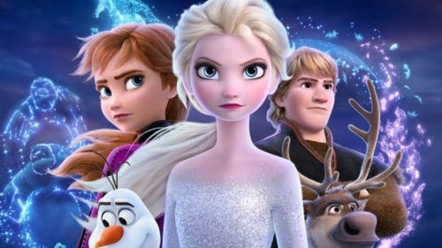
So what?
AI TRAINING CORPUS talk through
Disney’s “Cease and Desist” letters
Which pillars are involved?
Copyright infringement
Database right
Licensing
Research exceptions
Commercial vs non-commercial TDM
This Photo by Unknown Author is licensed under CC BY-NC-ND
Notes:
https://deadline.com/2025/12/disney-google-cease-and-desist-letter-1236645802/
Risk v. legality v. enforcability

Slide 20
Any Questions?
Any Questions

